Slide 1
Sentiment Analysis Part II User Generated Content Analytics
September 26, 2017

Slide 2
A More Practical Approach: Unsupervised Sentiment Analysis
Use weights (e.g., +5 to -5) on a list of words (lexicon)
Essentially add up individual weights in a sentence
Some nuances including sentiment shifters (e.g., “However”, “But”, etc.)
Used widely, e.g., SentiStrength (free tool)
Can be made context sensitive by adjusting weights and/or adding words

Slide 3
Multiple Products, Multiple Attributes
“The lobby of the Coastal Delight was cool, but the room was nothing to write home about; the food was good, but the location was too far away from transportation. In hindsight, although the Tuscany Grand was very pricey, its awesome location and high-end ambience would have been great.”
Assumption: People express emotions in close proximity to the mentions of entities and/or attributes.
Extract only phrases that are “relevant”
E.g., Dell & warranty, hotel & lobby, etc.
Then pass through standard sentiment analyzers

Slide 4
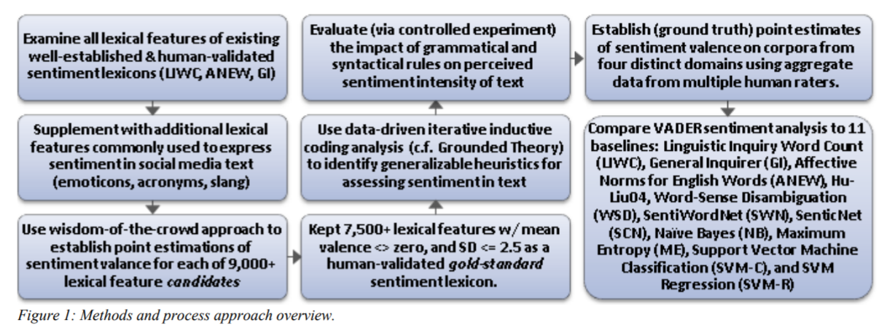
Valence Aware Dictionary for sEntiment Reasoning (VADER)
A more refined approach to unsupervised sentiment analysis
Available in Python
Source: Hutto & Gilbert 2014

Slide 5
Adds Human Heuristics for Expressing Sentiments
Punctuation, e.g., ! increases the sentiment intensity
Capitalization, e.g., ALL-CAPS
Degree modifiers, e.g., “The service here is extremely good”
Sentiment shifters, e.g., “The food here is great, but the service is horrible”
Trigram preceding a sentiment-laden lexical feature: Catch nearly 90% of cases where negation flips the polarity of the text.
E.g., “The food here isn’t really all that great”.
Source: Hutto & Gilbert 2014

